Slide 2
If f(z) is analytic in some simply connected region R , then
For any closed contour γ completely
Contained in R

Slide 3
Proof:
Writing z as z=x+iy
And f(z) as f(z) = u(x,y)+iv(x,y)
And then gives
From Green’s Theorem

Slide 4
So from Green’s Theorem this becomes,
But the Cauchy-Reimann equations require that
So

Slide 6

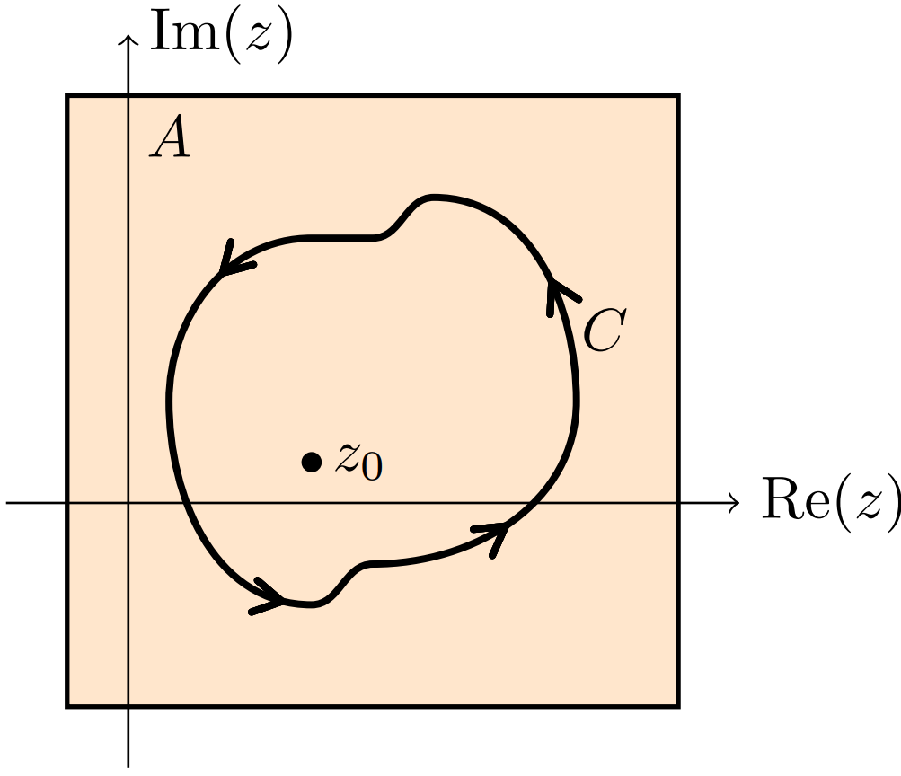
CAUCHY INTEGRAL FORMULA
Proof. (of Cauchy’s Integral Formula) We use a trick that is useful enough to be worth remembering. Let

Slide 7
Since f(z) is analytic on A, we know that g(z) is analytic on A-{z₀}. Since the derivative of f exists at z₀ , we know that
That is, if we define g(z₀) = f’(z₀) then g is continuous at z₀. From the extension of Cauchy’s Theorem just above, we have
Thus
(The last equality follows from our well known integral of
1/(z - z₀) on a loop around z₀.)

Slide 8
Let s = Re^{it} and z = re^{iθ} with r < R
Consider
N(R, r, t-θ) = -2R log|s-z|
= -R log [R^{2 –} 2rRcos(t-θ)+r²]
Since N(R, r, t-θ) is real part of -2Rlog(z-s), it is harmonic in interior of the circle |z| = R

Slide 9
Let s = Re^{it} and z = re^{iθ} with r < R
Consider
N(R, r, t-θ) = -2R log|s-z|
= -R log [R^{2 –} 2rRcos(t-θ)+r²]
Since N(R, r, t-θ) is real part of -2Rlog(z-s), it is harmonic in interior of the circle |z| = R

Slide 10
For r ≠ 0,
where P(R,r,t-θ) is the Poisson kernel.
Hence N can be used to have an integral representation for a harmonic function U, whose normal derivative U_{r} assume prescribed values, say H(θ)
Let H be piecewise continuous and U₀ be an arbitrary constant. Then,

Slide 11
Since the integrand of the above integral is harmonic, U(r,θ) is harmonic
Assume
This gives

Slide 12
By the solution of the Dirichlet Problem, this gives,
Hence, when H is piecewise continuous and satisfies
solves the Neumann problem for the region interior to the circle
r = R, where H(θ) is the normal derivative of the harmonic
function U(r, θ) at the boundary

